Slide 1
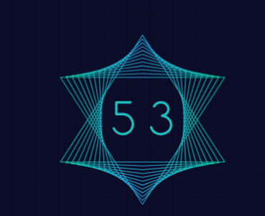

The Lost art of Legacy Program
The underlying coding of modern civilation

Slide 2
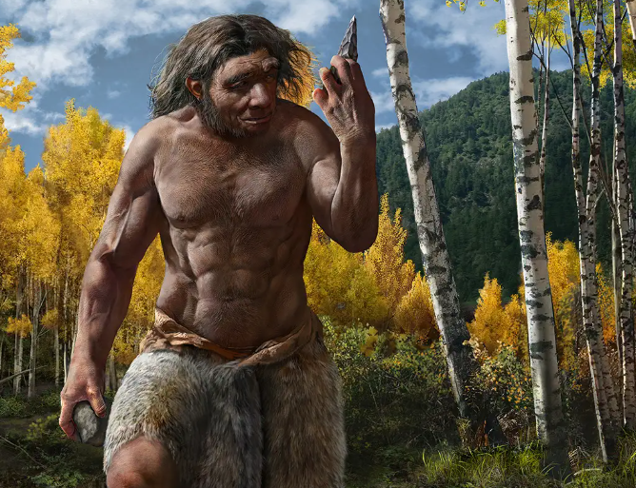
First computer

Slide 3
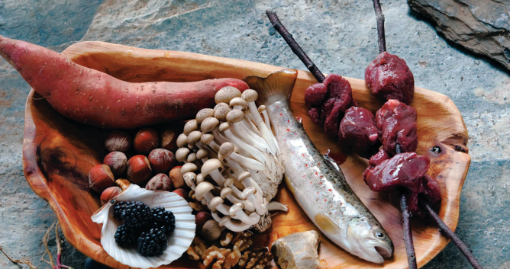
First program

Slide 4
Start
Search for item of the earth
Put item into mouth
Did you Die
Yes
No
End

Slide 5
Early History of autonomous
Talos (silver standard) created by Hephaestus
Automata (gold standard) created by Hephaestus
Hero of Alexandria(gold standard)
Automate Therapaenis(Bronze standard)
Human foragers
Water gatherer

Slide 8
END

